Slide 1
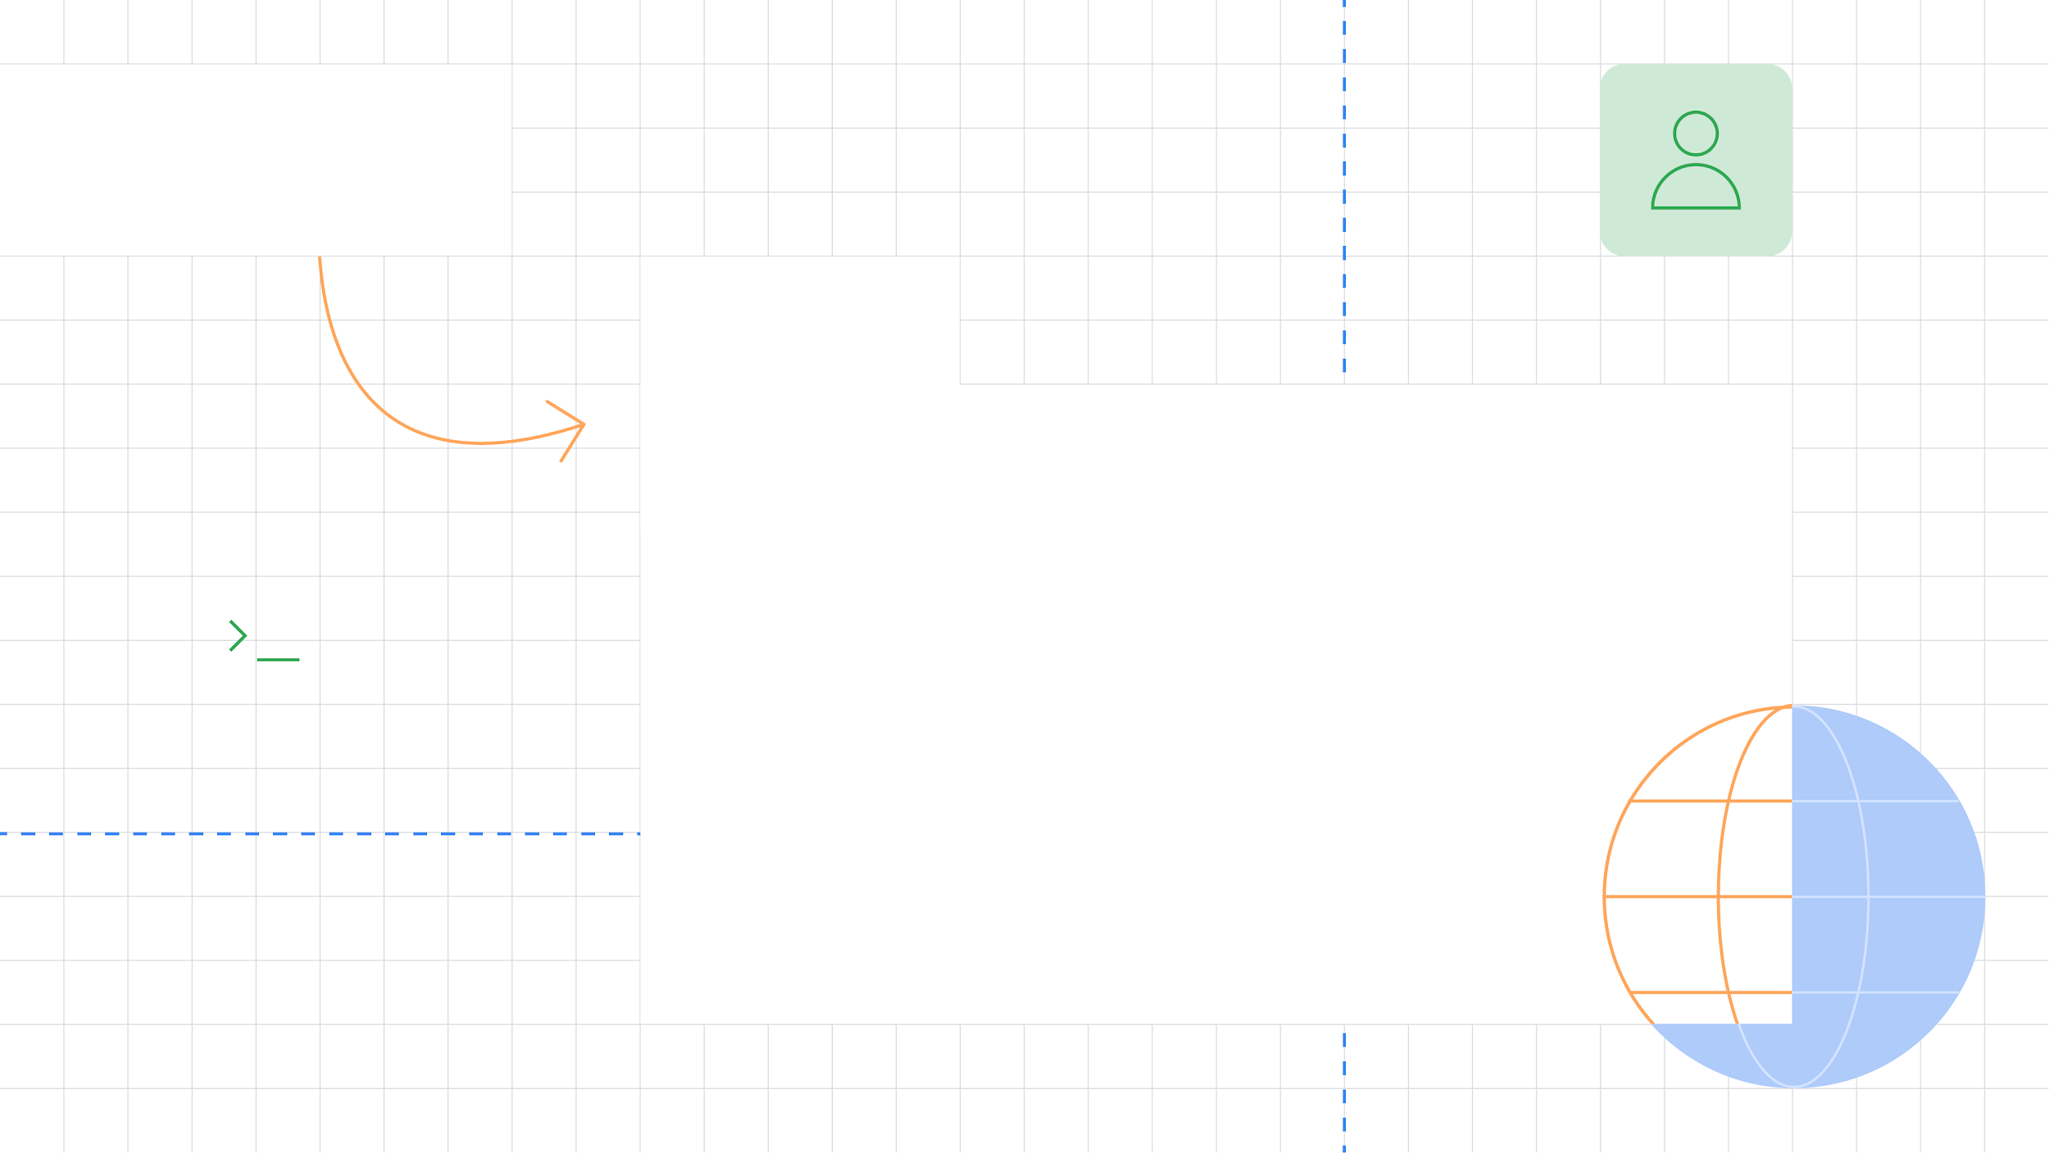



Deep Learning for Tabular Data
Integrating TensorFlow/Keras and Scikit-learn worlds
GDE program
Luca Massaron
GDE in Machine Learning
@lmassaron

Slide 2

Time to start

Slide 3
Agenda
Challenges for DNN for tabular data
Exploring the data pipeline
Cross validation as the right approach
Wrapping up with generators and tf.data
A working example
Motivations for using DNN for tabular data

Slide 4
A short recap on the topic
Deep learning is a subset of machine learning, which in turn is a subset of artificial intelligence (AI).
Deep learning is just a subset of AI, but it is an important subset. You see deep learning used for a wide number of tasks, but not every task.
Deep Neural Networks (DNN) are the algorithms behind deep learning.

Slide 5
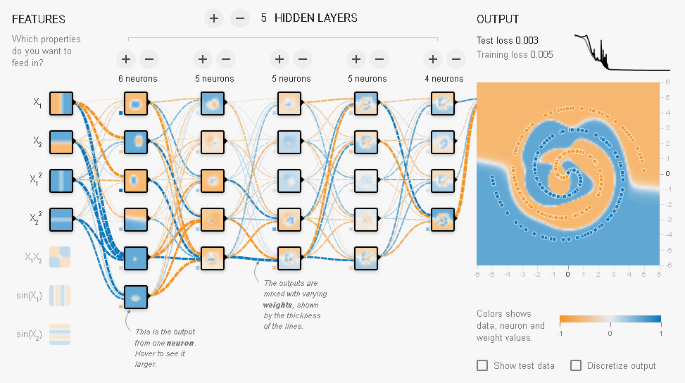
How a DNN works
https://playground.tensorflow.org/

Slide 6
Why it is relevant?
Machine learning, and especially deep learning, is associated with the idea of software 2.0 (see Andrej Karpathy, senior director AI, Tesla): in such a paradigm you have software not programmatically defined, but taught by examples.

Slide 7
Great advances in DNNs
Self-driving cars
Deep learning in healthcare
Deep learning in search engines
Voice Search & Voice-Activated Assistants
Automatic Machine Translation
Sophisticated recommender systems
Image generation and manipulation
...

Slide 8
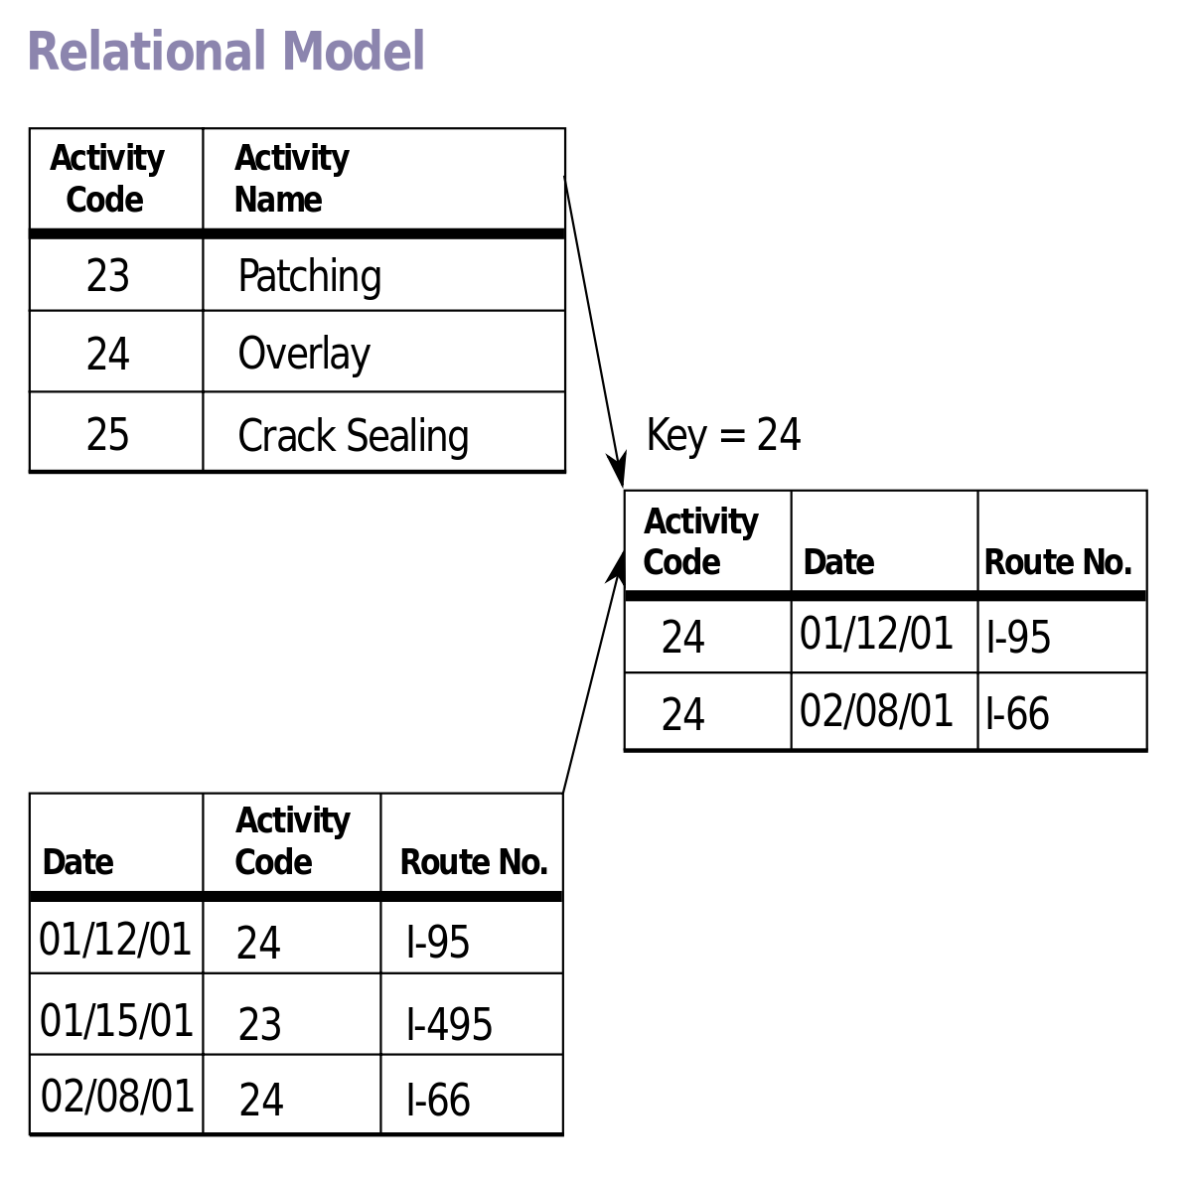
But most data are not images or text
Images or text are not the most frequent data you handle. Since long, relational databases have fostered the storage a mix of numeric, symbolic and textual data, scattered all together through tables.

Slide 9
Challenges of tabular data
Mixed features data types
Sparse data which is not the best for DNN
No SOTA/ best practice architecture
Less data than in image recognition problems
There’s suspect from non technical people because DNN are less interpretable than simpler ML algorithms
Often no best in class solution, because GBM might perform better

Slide 10
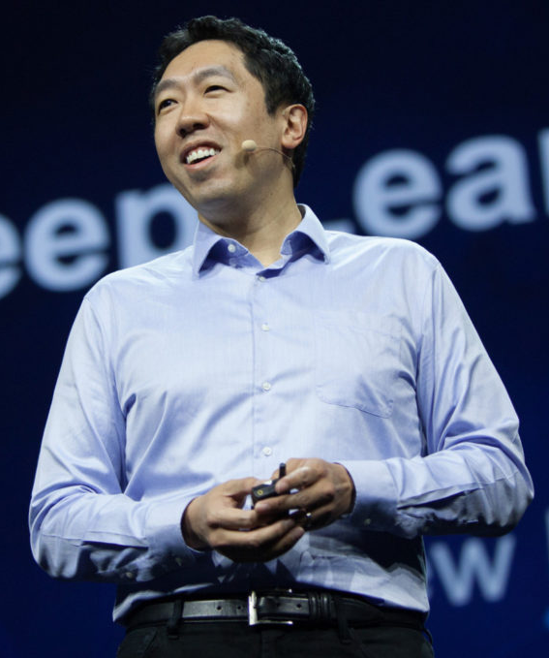
But don’t get discouraged
The challenges are serious, so are the opportunities
Andrew Ng: “Deep learning has seen tremendous adoption in consumer Internet companies with a huge number of users and thus big data, but for it to break into other industries where datasets sizes are smaller, we now need better techniques for small data”

Slide 11
To successfully use DNNs for tabular
It takes some effort, don’t expect an automated process or great results at once
Don’t re-invent the wheel: use TensorFlow 2, its level API Keras, Scikit-learn, Pandas
Process and pipeline input accordingly to its type
Create a suitable neural architecture keeping into account the number of available examples
Encode prior knowledge (feature engineering)
Test and tune your network using cross validation

Slide 12




Use the right tools
+
High level API
Robust and effective
Production ready
.fit .transform methods
A host of classes for data processing
Cross-validation

Slide 13
Let’s dive into data pipeline
Start by dividing the input data into: - numeric variables - dates - categorical : . Ordinal . Low cardinality
. High cardinality

Slide 14

Numeric data

Slide 15
Numeric variables
Trash low variance variables
Deal with missing values: just input the median, but don’t forget to create missing indicators to catch any information in missingness not at random
Strive to make your data more gaussian-like
Catch outliers (or be confident that your BatchNormalization layer will)
Normalize all the values before feeding into the dnn or use a batchnorm layer after the input

Slide 16
Tricks and tips of the trade
Feature selector that removes all low-variance features.
from sklearn.feature_selection import VarianceThreshold
X = [[0, 2, 0, 3], [0, 1, 4, 3], [0, 1, 1, 3]]
selector = VarianceThreshold(threshold=0.0)
selector.fit_transform(X)
Imputation of missing values.
import numpy as np
from sklearn.impute import SimpleImputer
X = [[7, 2, 3], [4, np.nan, 6], [10, 5, 9]]
imp_mean = SimpleImputer(missing_values=np.nan, strategy='median')
imp_mean.fit_transform(X)

Slide 17
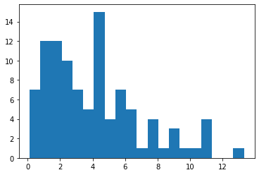
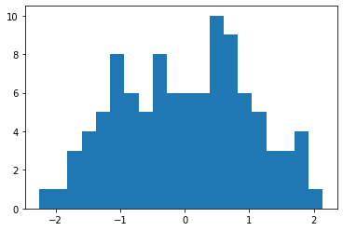
Tricks and tips of the trade
Apply a power transformation to make data more Gaussian-like.
import numpy as np
import matplotlib.pyplot as plt
from sklearn.preprocessing import PowerTransformer
rng = np.random.RandomState(0)
X = np.sort(rng.chisquare(4, 100), axis=0).reshape(-1, 1)
pt = PowerTransformer(method='yeo-johnson', standardize=True)
Xt = pt.fit_transform(X)

Slide 18
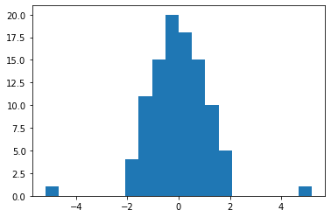
Tricks and tips of the trade
Transform features using quantiles information spreading out the most frequent values and reducing the impact of outliers.
import numpy as np
import matplotlib.pyplot as plt
from sklearn.preprocessing import QuantileTransformer
rng = np.random.RandomState(0)
X = np.sort(rng.chisquare(4, 100), axis=0).reshape(-1, 1)
qt = QuantileTransformer(n_quantiles=10, output_distribution='normal', random_state=0)
Xt = qt.fit_transform(X)

Slide 19
Tricks and tips of the trade
Transforms by removing the mean and scaling to unit variance
.
import numpy as np
from sklearn.preprocessing import StandardScaler
X = [[ 1., -2., 2.], [ -2., 1., 3.], [ 4., 1., -2.]]
sc= StandardScaler()
sc.fit_transform(X)
This Scaler removes the median and scales the data according to the Interquartile Range (IQR). The IQR is the range between the 1st quartile (25th quantile) and the 3rd quartile (75th quantile).
import numpy as np
from sklearn.preprocessing import RobustScaler
X = [[ 1., -2., 2.], [ -2., 1., 3.], [ 4., 1., -2.]]
rsc= RobustScaler()
rsc.fit_transform(X)

Slide 20

Dates

Slide 21
Dates
Parse dates and split them into: year, month, week, day of the year, day of the month, day of the week
Mark special dates or periods, such as holidays, festivities, relevant events
For every split, prepare one hot encoding and cyclic continuous transformations (sin / cos)

Slide 22
Tricks and tips of the trade
Using the type datetime64, you can easily extract the time parts
.
import pandas as pd
df = pd.DataFrame({'col1': ['02/03/2017', '02/04/2017', '02/05/2017’]})
df['col1'] = df['col1'].astype('datetime64[ns]')
df.col1.dt.year, df.col1.dt.month, df.col1.dt.weekofyear,\
df.col1.dt.day, df.col1.dt.dayofyear, df.col1.dt.dayofweek
Using sine and cosine transformations, create periodic features
import pandas as pd
import numpy as np
df = pd.DataFrame({'col1': ['02/03/2017', '02/04/2017', '02/05/2017']})
df['col1'] = df['col1'].astype('datetime64[ns]')
cycle = 7
df['weekday_sin'] = np.sin(2 * np.pi * df['col1'].dt.dayofweek / cycle)
df['weekday_cos'] = np.cos(2 * np.pi * df['col1'].dt.dayofweek / cycle)

Slide 23

Categorical data

Slide 24
Low cardinality
If a categorical variable has less than 2-255 values, just one-hot-encode.
Color
Red
Green
Blue
Color_red | Color_green | Color_blue
1 | 0 | 0
0 | 1 | 0
0 | 0 | 1
from sklearn.preprocessing import OneHotEncoder
import pandas as pd
df = pd.DataFrame({'col1': ['red color', 'blue color', 'green color']})
ohe = OneHotEncoder(categories='auto', sparse=False)
ohe.fit_transform(df[['col1']])

Slide 25
Categorical ordinal
For every ordinal, just let the variable as it is and one hot encoded it (you will catch both linear and non-linear ordinal effects)
from sklearn.preprocessing import OneHotEncoder
import pandas as pd
df = pd.DataFrame({'col1': [1, 2, 3]})
ohe = OneHotEncoder(categories='auto', sparse=False)
ohe.fit_transform(df[['col1']])

Slide 26
High cardinality
If a categorical variable as many different levels, convert it into numeric labels and use an embedding layer (Guo, Cheng, and Felix Berkhahn. "Entity embeddings of categorical variables." arXiv preprint arXiv:1604.06737, 2016).
from sklearn.preprocessing import LabelEncoder
import pandas as pd
df = pd.DataFrame({'col1': ['red color', 'blue color', 'green color']})
le = LabelEncoder()
le.fit_transform(df['col1'])
dictionary_length = len(le.classes_)

Slide 27
Embedding layer
An embedding layers is just a matrix of weights, converting the input size (a numbered dictionary) to a lower dimensionality output (the embedding size)
It is a weighted linear combination whose weights are optimized to prediction
The resulting embedding is exportable and reusable for other problems

Slide 28
How an embedding layer works
Text on variable: ID_8080
Pre-processing
Label Encoding: 3 / 2400
One Hot Encoding vector (size = 2400,)
[ 0 0 1 0 0 0 0 0 0 0 0 0 0 … 0 0 0 0 0 0 0 0 0 0 0 0 0 0 0]
Weights matrix (size input x output, i.e. 2400x4)
Embeddings
tf.keras.layers.Embedding( input_dim, output_dim)
[[0.48 0.997 … 0.706 0.475]
...
[0.794 0.922 … 0.086 0.921]]
Output vector (size = 4,)
Backpropagation
[0.283, 0.34 , 0.789, 0.867]
Dense layers
Target
Fully connected

Slide 29
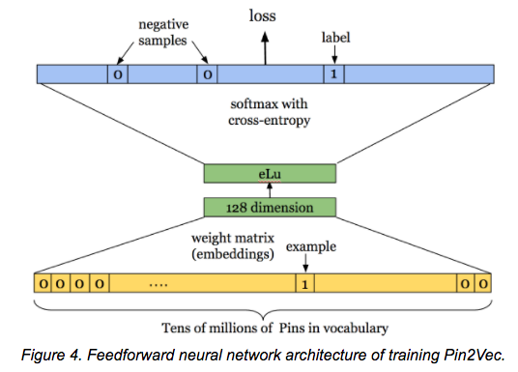
Storing away embeddings
Pinterest: “Applying deep learning to Related Pins” (Pin2vec : https://medium.com/the-graph/applying-deep-learning-to-related-pins-a6fee3c92f5e)
Instacart: “Deep Learning with Emojis (not Math)” (embeddings for grocery items: https://tech.instacart.com/deep-learning-with-emojis-not-math-660ba1ad6cdc)
layer_no = 10
emb = model.layers[layer_no].get_weights()[0]
np.save(file="emb.sav", arr=emb)

Slide 30
Dirty low and high cardinality
If a categorical variable has dirty/fuzzy values, convert it into a sequence of shingles and feed it to an embedding layer
Cerda, Patricio, Gaël Varoquaux, and Balázs Kégl. "Similarity encoding for learning with dirty categorical variables." Machine Learning 107.8-10 (2018): 1477-1494. From abstract: “We draw practical recommendations for encoding dirty categories: 3-gram similarity appears to be a good choice to capture morphological resemblance.”

Slide 31
n-grams for approximate matching
Pfizer Inc. -> ['Pfi', 'fiz', 'ize', 'zer', 'er ', 'r I', ' In', 'Inc', 'nc.']
Pfizer LCC -> ['Pfi', 'fiz', 'ize', 'zer', 'er ', 'r L', ' LC', 'LCC']
By converting a string to a set of n-grams, it can be embedded in a vector space, thus allowing the sequence to be compared to other sequences in an efficient manner.

Slide 32
Generating shingles
from sklearn.feature_extraction.text import CountVectorizer
import pandas as pd
df = pd.DataFrame({'col1': ['Pfizer Inc.', 'Pfizer Pharmaceuticals LLC', 'Pfizer International LLC',
'Pfizer Limited', 'Pfizer Corporation Hong Kong Limited', 'Pfizer Pharmaceuticals Korea Limited']})
cvect = CountVectorizer(ngram_range=(3, 3), analyzer='char')
cvect.fit(df['col1'])
def nonzero_byrow(X):
sequence = list()
for row in range(X.shape[0]):
_, nonzero = np.nonzero(X[row, :])
sequence.append(nonzero)
return sequence
nonzero_byrow(cvect.transform(df['col1']))

Slide 33

Cross validation

Slide 34
Cross validation is the key
When dealing with multiple pipelines, it is advisable having a data generator or using tf.data.
If you do, keep it simple and straightforward, allowing to filter training from testing examples
Most important, have care to create a cross-validation loop to check the performances of an overly parameterized model (params >> examples)

Slide 35
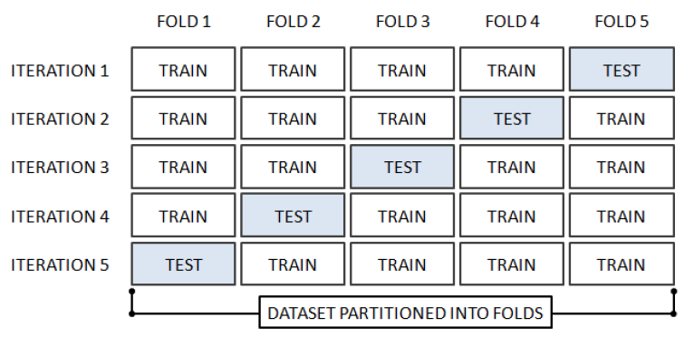
Cross validation primer
It splits your data into a number k of folds (portions of your data) of equal size. Then, each fold is held out in turn as a test set and the others are used for training. Each iteration generates a representative error estimate.

Slide 36
Cross validation primer
import numpy as np
from sklearn.model_selection import KFold
X = ["a", "b", "c", "d"]
kf = KFold(n_splits=2)
for train, test in kf.split(X):
print("%s %s" % (train, test))
KFold divides all the samples in groups of samples, called folds of equal sizes (if possible)
StratifiedKFold is a variation of k-fold which returns stratified folds: each set contains approximately the same percentage of samples of each target class as the complete set.
GroupKFold is a variation of k-fold which ensures that the same group is not represented in both testing and training sets.
TimeSeriesSplit is a variation of k-fold which returns first folds as train set and the th fold as test set.

Slide 37

Wrapping up for TF

Slide 38
Machine Learning Pipeline
X, y as pandas DataFrame
Tabular processor
Scikit-learn: Pipeline,
various transformers
Cross-validation loop
Data generator
tf.data.Dataset
Keras model
tf.estimator
TensorFlow model
…
…
…
https://github.com/lmassaron/deep_learning_for_tabular_data

Slide 39
Tabular processor
class TabularTransformer(BaseEstimator, TransformerMixin):
def __init__(self, numeric=list(), ordinal=list(), lowcat=list(), highcat=list()):
self.numeric = numeric
self.ordinal = ordinal
self.lowcat = lowcat
self.highcat = highcat
…
def fit(self, X, y=None, **fit_params):
…
def transform(self, X, y=None, **fit_params):
… def fit_transform(self, X, y=None, **fit_params):
self.fit(X, y, **fit_params)
return self.transform(X)

Slide 40
Data Generator
class DataGenerator(tf.keras.utils.Sequence):
def __init__(self, X, y, tabular_transformer, batch_size=32,
shuffle=False, dict_output=False):
self.tbt = tabular_transformer
…
def __iter__(self):
…
def __next__(self):
…
def __call__(self):
…
def __data_generation(self, selection):
return self.tbt.transform(self.X.iloc[selection, :]), self.y[selection]
def __getitem__(self, index):
indexes = self.indexes[index*self.batch_size:(index+1)*self.batch_size]
samples, labels = self.__data_generation(indexes)
return samples, labels

Slide 41
tf.data
import tensorflow as tf
tb = TabularTransformer(numeric=num_cols, lowcat=lcat_cols, highcat=hcat_cols)
tb.fit(X)
sizes=tb.shape(X)
print(f"output dimensionality: {sizes}")
training_generator = DataGenerator(X, y, tabular_transformer=tb,
batch_size=10, shuffle=True, dict_output=True)
dataset = tf.data.Dataset.from_generator(training_generator,
output_types=({"input_0": tf.float32, "input_1": tf.int32}, tf.int32))

Slide 42

Neural architectures

Slide 43
Define the right architecture
Start small, try first a shallow layer with linear activations
Then try adding non linearity (relu, leaky relu, elu, selu, gelu)
Try stacking more layers (2 to 3 at first, then more)
Filter inputs using BatchNormalization
Use dropout to control overfitting (but remember it doesn’t get along with batch normalization) or, if you are using a shallow architecture, L2 regularization.
Embed the logic you devise into a parametric function

Slide 44

An example
Based on the Kaggle competition, “Amazon.com - Employee Access Challenge”, a competition notable for the high cardinality variables involved, the example compares the development and performances of a GBM model built with the CatBoost algorithm and a deep neural network for tabular data.
https://www.kaggle.com/lucamassaron/deep-learning-for-tabular-data
https://github.com/lmassaron/deep_learning_for_tabular_data

Slide 45
A peek at the used DNN
def tabular_dnn(numeric_variables, categorical_variables, categorical_counts,
feature_selection_dropout=0.2, categorical_dropout=0.1,
first_dense = 256, second_dense = 256, dense_dropout = 0.2, ):
numerical_inputs = Input(shape=(len(numeric_variables),))
numerical_normalization = BatchNormalization()(numerical_inputs)
numerical_feature_selection = Dropout(feature_selection_dropout)(numerical_normalization)
categorical_inputs = []
categorical_embeddings = []
for category in categorical_variables:
categorical_inputs.append(Input(shape=[1], name=category))
category_counts = categorical_counts[category]
categorical_embeddings.append(
Embedding(category_counts+1,
int(np.log1p(category_counts)+1),
name = category + "_embed")(categorical_inputs[-1]))
categorical_logits = Concatenate()(
[Flatten()(SpatialDropout1D(categorical_dropout)(cat_emb))
for cat_emb in categorical_embeddings])

Slide 46
A peek at the used DNN
x = concatenate([numerical_feature_selection, categorical_logits])
x = Dense(first_dense, activation=‘gelu’)(x)
x = Dropout(dense_dropout)(x)
x = Dense(second_dense, activation=‘gelu’)(x)
x = Dropout(dense_dropout)(x)
output = Dense(1, activation="sigmoid")(x)
model = Model([numerical_inputs] + categorical_inputs, output)
return model
The deep learning model presented in the notebook is compared to CatBoost, a gradient boosting solution which is considered as the state of the art for tabular data with categorical variables.
Castboost can achieve a test score of 0.876 Roc Auc score, the DNN model 0.863, when both blended together, 0.882., demonstrating how a blend between a GBM and a DNN achieves best results.

Slide 47
Pro-tips (but there’s no free lunch)
Try different activations: start first with ReLU and Leaky and then try more specific functions such as SeLU, GeLU (Gaussian Error Linear Unit), Mish. Just make them custom objects using get_custom_objects().update({})
Try cosine similarity loss in place of log-loss: for some problems it resulted in better results
Try ensembling more DNNs by sampling rows (sub-sampling or bootstrapping) and columns
Try augmenting the examples available by adding random noise, using SMOTE or Mixup augmentation

Slide 48
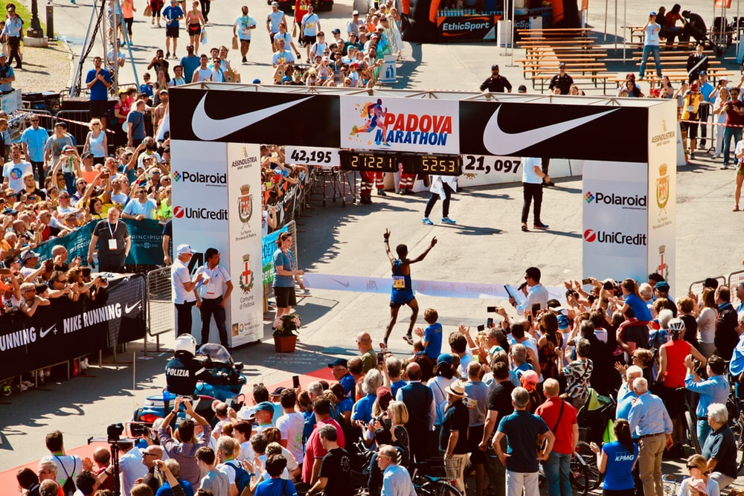
Conclusion

Slide 49
Wrap up
DNN for tabular data are an alternative solution for modelling a response given tabular data
They require an ad-hoc architecture and a well crafted pipeline, so they are not effortless, but you can get far integrating TensorFlow and Scikit-learn in your code
Entity Embeddings of categorical data can be of great use when dealing with high dimensional data relevant to the problem
Most of the time they can be competitive with GBM solutions, and often they complete them (blending can help reaching better and more stable models)

Slide 50





Thank you!! Q&A
Luca Massaron
Google Developer Expert
https://developers.google.com/community/experts/directory/profile/profile-luca_massaron
 | https://www.linkedin.com/in/lmassaron/
 | https://twitter.com/lucamassaron
 | https://github.com/lmassaron
 | https://www.amazon.com/Luca-Massaron/e/B00RW7GV02

